Slide 1
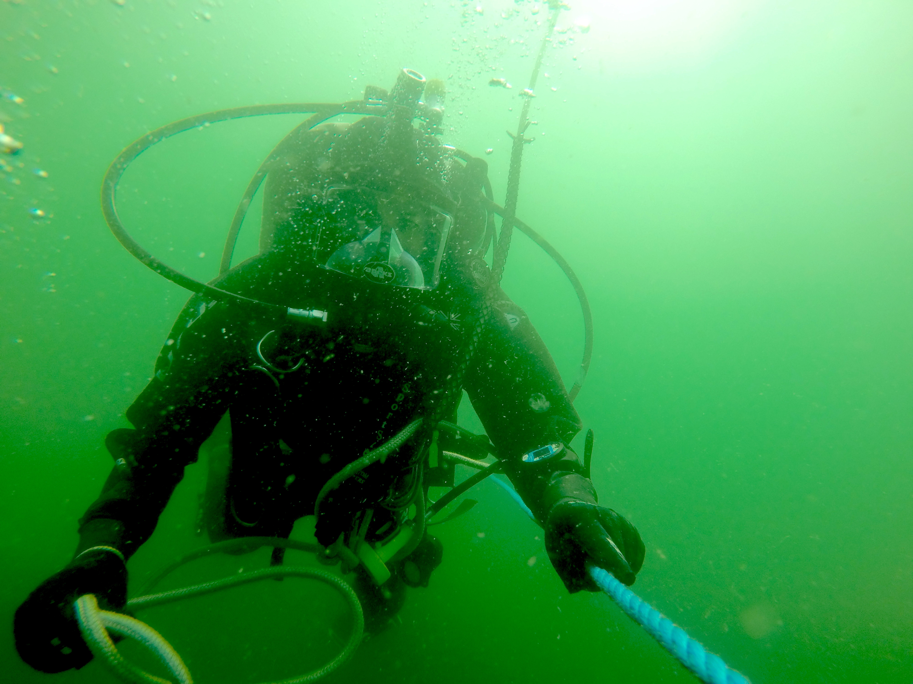
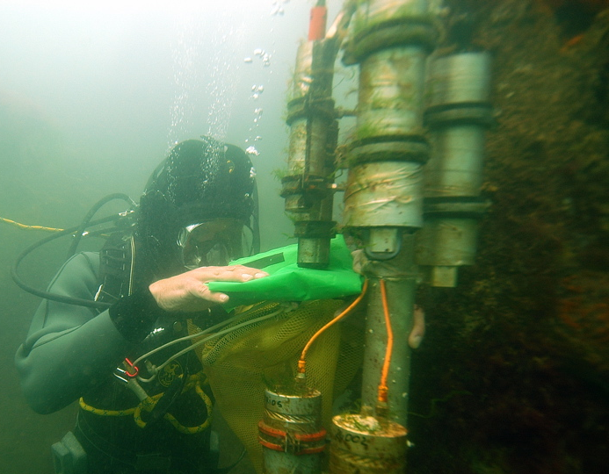
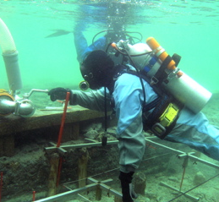
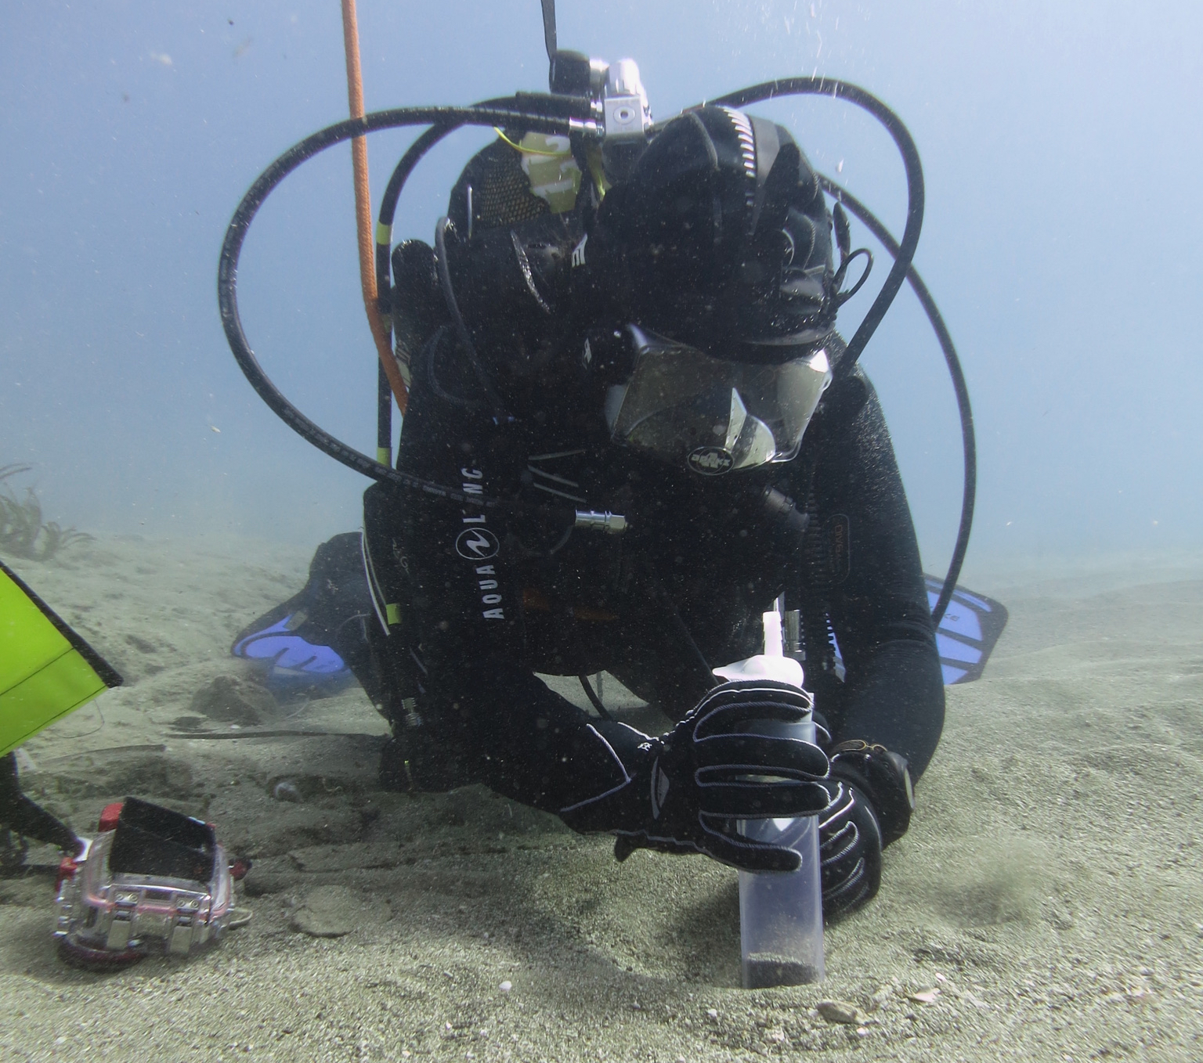
Kommission Forschungstauchen Deutschland
10th Symposium 2017
„Scientific Diving in Germany,
Europe and beyond“
(German Commission for Scientific Diving)
02.11.2017- 03.11.2017 in Bremerhaven/Germany
Organizer:
Alfred-Wegener-Institut for Polar and Marine Research (AWI)
Leibniz Centre for Tropical Marine Research (ZMT)
German Maritime Museum (DSM)
Registration:
http://www.forschungstauchen-deutschland.de/index.php/registration-symposium-2017

