Slide 1

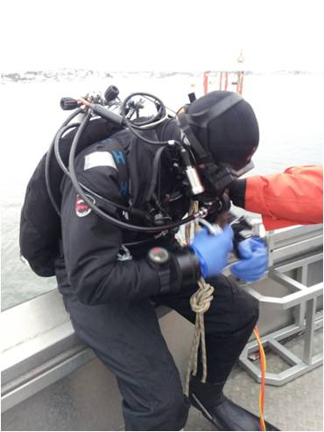
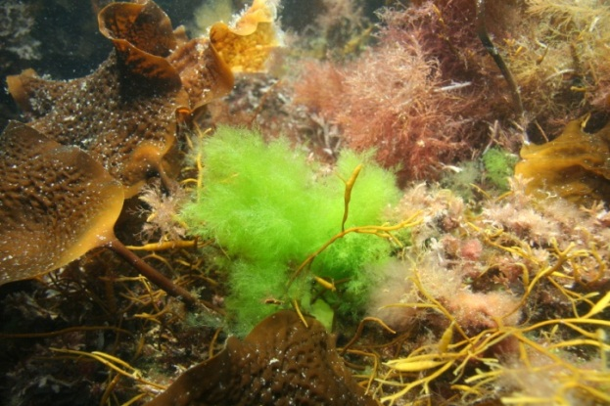
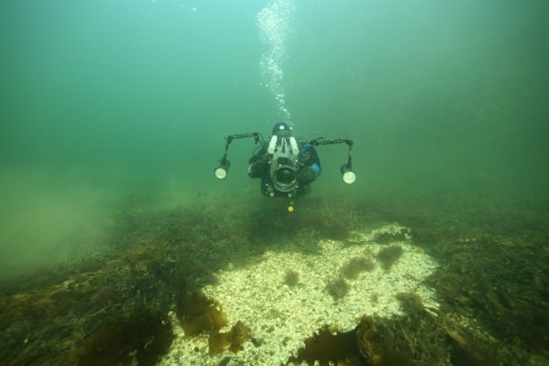
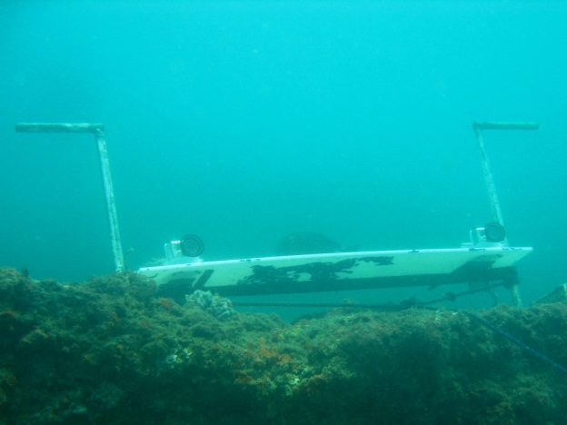
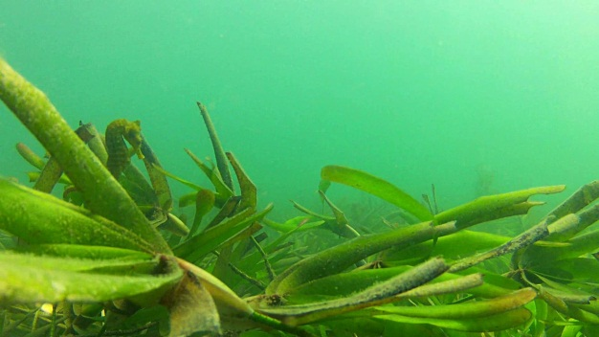
International
PhD-student Course in
Scientific Diving and Documentation techniques (4ECT)
Dept. Biological and Marine Sciences
and
Sven Lovén Centre for Marine Sciences
Time: August 18th – 29th, 2014
Place: Lovéncenter-Kristineberg, University of Gothenburg, Fiskebäckskil
Deadline for application: May 31st , 2014
Syllables:
Illustration techniques using scientific diving underwater digital photography; handling of photographic equipment, in water, optimization of lighting, macro- and wide angel photography, composition of picture, imaging in photoshop
Underwater digital photography for empirical studies including stereo-photography to quantify changes in the environment, quantification by visual census methods, underwater photography to study distribution and coverage and alternative methods such as sledges, drop-videos and underwater observatories
Stereo-video system techniques for quantitative analysis and behavior of mobile organisms
Medical examination and CPR course, which are required for diving during your studies.
Rules and regulatory frames of Scientific Diving, dive planning and risk assessment, repetition of dive medicine and rescue techniques
Teachers :
Anders Salesjö is a marine biology teacher and one of Scandinavia's topmost underwater photographers.
Fredrik Pleijel is a researcher in marine zoology specialized in polychaete phylogeny and taxonomy. Currently he has a grant from the Hasselblad Foundation to photo-illustrate Swedish marine invertebrates.
Lars-Ove Loo is a researcher in marine ecology and has worked with benthic-pelagic coupling in different ecosystems, mapping of different marine habitats and processing historical marine biological data. He uses photography and filming as a tool in his research.
Linus Hammar is a reseacher working with ecological risk assessment of offshore renewable energy; including resource mapping, field experiments on fish, and ecological risk assessment at the landscape level. He uses stereo-video system techniques to record and quantify detailed fish movements.
Maria Asplund is a researcher in marine ecology and responsible for the development of Scientific Diving at Sven Lovén Centre for marine research.
For more information visit: http://www.bioenv.gu.se/Utbildning/utbildning-pa-forskarniva/kurser-samlat-kursutbud/
Contacts: maria.asplund@gu.se
Photo credit: Marcus Stenegren
Photo credit:
Tom Stavely
Photo credit: Maria Asplund
Photo credit: Lars-Ove Loo
Photo credit: Linus Hammar
Photo credit: Linus Hammar

